Slide 1


Content Analysis

Slide 2


Today's agenda
Project recap
Problem
The Analytics team
Process
Insights
Summary

Slide 3

Social Buzz is a fast-growing technology unicorn that needs to adapt quickly to its global scale. Accenture has begun a 3-month POC focusing on these tasks:
An audit of Social Buzz's big data practice.
Recommendations for a successful IPO.
Analysis to find Social Buzz's top 5 most popular categories of content.
Project Recap

Slide 4

Problem
The business seeks to understand:
What are the top 5 most engaging content categories?
How many unique content categories exist?
Which category received the most reactions?
When was the peak month for content posting?

Slide 5



Marcus Rompton
(Senior Principal)
The Analytics team
Andrew Fleming
(Chief Technical Architect)
Habiba Mohammad
(Data Analyst)

Slide 6
Process
1
Data Understanding
2
Data Cleaning
3
Data Modeling
4
Data Analysis
5
Uncover Insights

Slide 7

Insights
Top 5 Categories
Animals
Food
Science
healthy eating
Technology

Slide 8
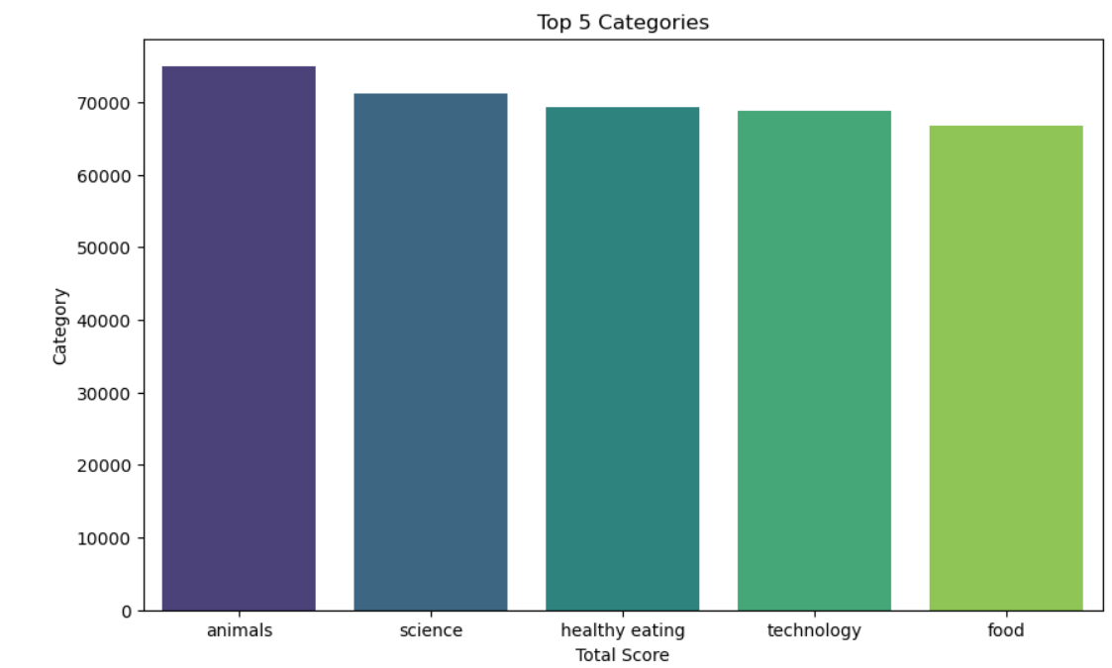

Slide 9

Number of unique categories
16 Categories

Slide 10
Number of reactions of the most popular category
1897 reactions

Slide 11
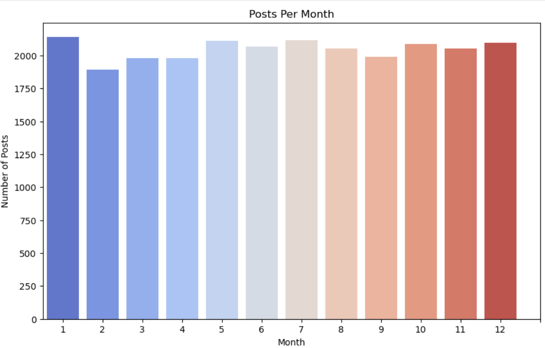
The month with the most posts
January

Slide 12

ANALYSIS
Animals and science are the two most popular categories of content, showing that people enjoy "real-life" and "factual" content the most.
INSIGHT
Food is a common theme with the top 5 categories with "Healthy Eating" ranking the highest. This may give an indication to the audience within your user base. You could use this insight to create a campaign and work with healthy eating brands to boost user engagement.
NEXT STEPS
This ad-hoc analysis is insightful, but it's time to take this analysis into large scale production for real-time understanding of your business. We can show you how to do this.
Summary

Slide 13
Thank you!
ANY QUESTIONS?

